Slide 1
What Are we doing?

Slide 2


Engineering ~ Sailing
Notes:
Seas are almost the same as before and will always be.; it’s the knowledge of seas that unknown. We’re exploring them and filling the gaps in this knowledge.
What is the start point? We need to know the big picture and details of the most important parts.

Slide 3
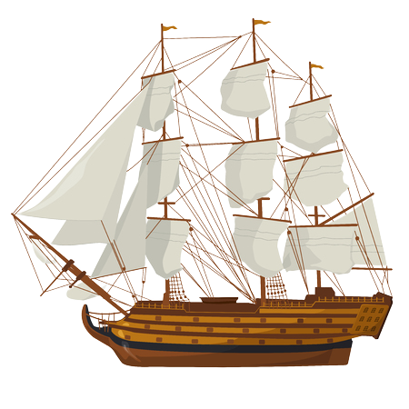
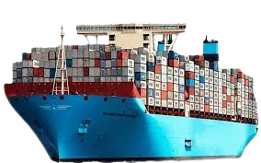
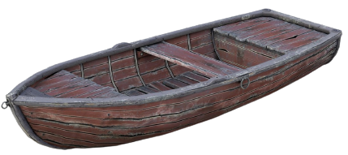
Engineering ~ Sailing
Notes:
Aside the seas, we need to know how the vessel itself to control its behaviour; but the vessel keeps changing.
When this changes occur, our knowledge on the vessel keep reducing but we don’t need to know all the information about the vessel, we need to know as much as information as possible about the seas.

Slide 4

Operator vs. Engineer
Notes:
We will learn some stuff to know how to be a operator of a specific service but we have to learn how to become a captain and to do so, we have to start a long journey.
Since this journey is not something that anyone could teach, we will try to teach how to get onboard and how to move forward along the way.

Slide 5
How tasks works?
You have until the next session to complete them
If you don’t, you will lack behind
The day before each session, a guideline about last session’s task will be provided for you
Try not to use it but since you may stuck on some sections, check the guideline to proceed
At first we wanted to create several groups with 5 member and run a Q/A session each week for each group but since this was not a scalable approach, we changed it to this approach
You will see that to complete each task, you need to research the crap out of it, otherwise you will not fulfil our purpose here
Cultivating mindset so you could be able to resolve any issues an design any needs

Slide 6
Reminder: What should you commit to?
Full knowledge of LPIC-1
Do not use Windows
You have to know a little bit of coding
If you don’t, start planning for it
AT LEAST 2 hours per day
Required hardware:
Minimum: 4/8
Recommended: 8/16
This is not all

Slide 7
Junior DevOps of very near future
Invest here
Get less sleep
Don’t go out with friends and families
Spend as much time as possible for this
ONLY FOR THE PERIOD OF THIS JOURNEY
If you commit, I personally guarantee that you will become a excellent DevOps

